Slide 1
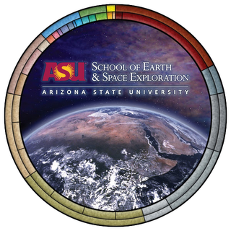
Investigating Four Newly Resolved Debris Disks in Scorpius-Centaurus
Kadin Worthen (Junior)
School of Earth and Space Exploration at Arizona State University
Advisors: Jennifer Patience and Justin Hom
April 18, 2020
Hom, J., Patience, J., Esposito, T., Duchene, G.,Worthen, K., et al. 2020, AJ, 59, 31H
Image Credit: NASA

Slide 2
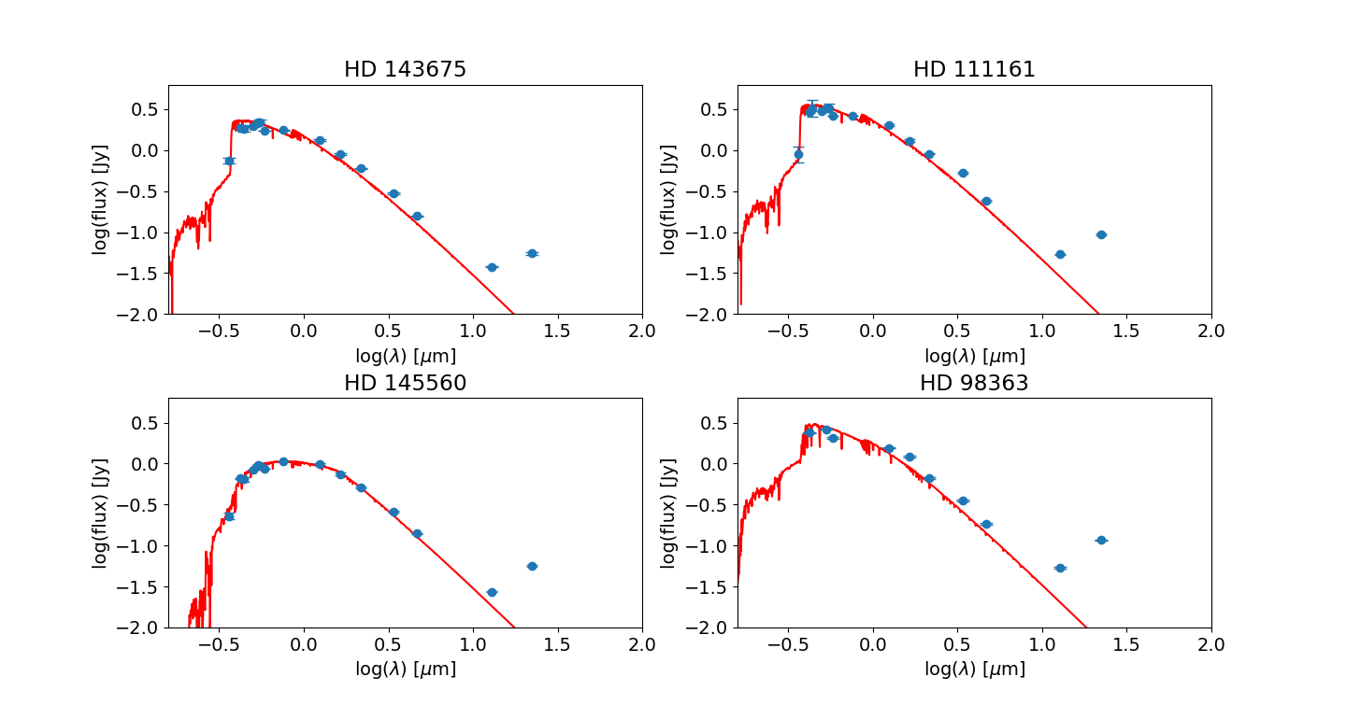
What are Debris Disks?
They consist of dust particles and planetesimals in orbit around a star.
Analogous to the Kuiper Belt in our Solar System
Their existence can be inferred by detecting an infrared excess
Infrared Excess

Slide 3
Motivation of Project
Images are needed to study the disk structure
Gaps or asymmetries in disks can indicate the presence of planets
Large planets in disk systems can be directly imaged
Since disks are much fainter than their stars, an instrument like the Gemini Planet Imager (GPI) must be used to image disks
Gemini South Telescope
Beta Pic Debris Disk
Image Source: Gemini
Credit: Lagrange et al. (2008)

Slide 4

Target Stars
We imaged four targets HD 145560, HD 111161, HD 98363, and HD 143675 with GPI
All four stars are members of the OB Association Sco-Cen with ages between 11 and 16 Myr.
HD 111161, HD 98363, and HD 143675 are A stars and HD 145560 is an F star, so all are more massive than our sun.
Credit: Wikipedia
Targets
Sun

Slide 5
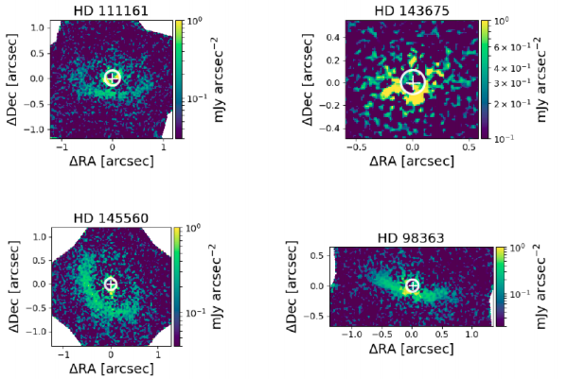
Disk Detection Images
All four disks were detected for the first time in scattered light
Images are in H-band (1.65 microns)
HD 98363 disk is asymmetric in brightness and shape
Credit: Hom, Patience, Worthen et al. (2020)

Slide 6
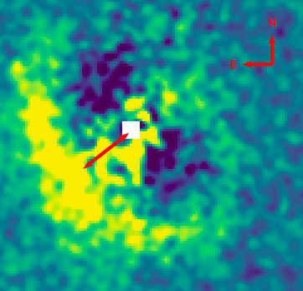
Disk Scale
Scale bar of 40 AU shows orbit of Pluto
Radius of Disk has angular size of .7 Arcseconds
Outer disk radius is larger than orbit of Pluto
40 AU

Slide 7
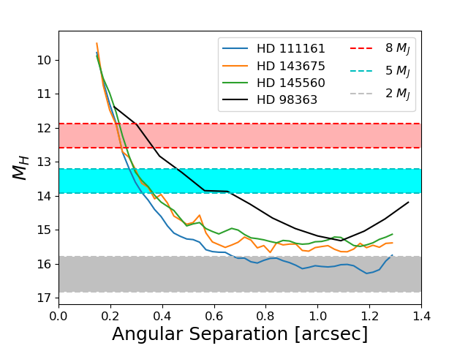
Planet Detection Results
We also looked for planets in our images
We did not detect planets in any of the images
Using contrast ratios, we determine the planet detection limit
10 Myr
15 Myr
10 Myr
15 Myr
10 Myr
15 Myr
Credit: Hom, Patience, Worthen et al. (2020)

Slide 8
Conclusions and Future Work
We successfully detected four debris disks for the first time in scattered light
We did not detect any planets in our four debris disk images
We could have detected planets 5 Jupiter masses and greater at angular separations above .6 arcseconds
We could not have detected planets with masses less than 2 Jupiter masses
Future work will involve an analysis of disk properties using computer models

